Slide 1
PROJECT NAME
High Level Model: Metadata
DW Data- bases
DW Database Contents
DW Subject Areas
DW Subject Area Contents
DW Objects
DW Attri-butes
DW Object Contents
The Data Warehouse Lifecycle Toolkit, 2nd Edition
Copyright 2008, Kimball Group

Slide 2
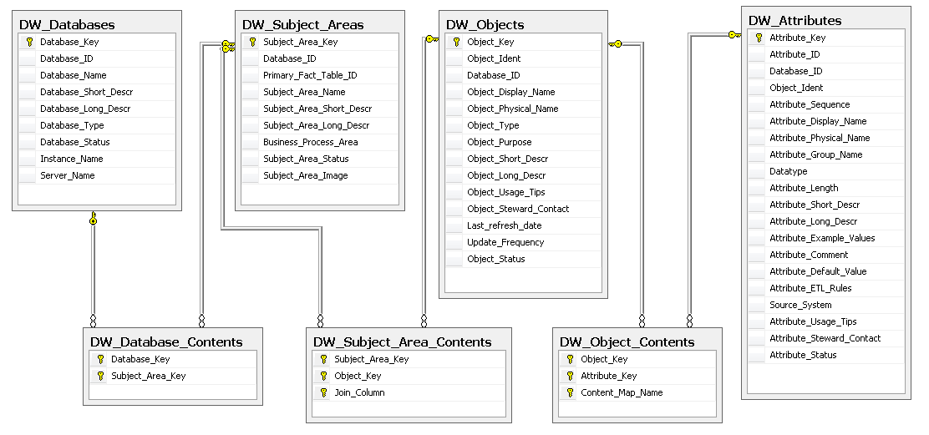
PROJECT NAME
Metadata Tables and Columns
The Data Warehouse Lifecycle Toolkit, 2nd Edition

